Slide 1
Welcome to Parents Do Maths
Our aim tonight is to explain how maths is taught in school and to show you examples of the processes that your children will use as they learn about different areas of the maths curriculum.
Live well, laugh together, learn forever
1
Notes:
Opal fruits

Slide 2
Welcome to Parents Do Maths
Our calculation policy aims to ensure that all pupils are supported to:
Understand the key principles of mathematics, enabling them to become fluent in basic mental and written methods.
Apply their knowledge of mathematics to understand and solve problems, including realistic “real world” problems that they may not be familiar with.
Can use mathematical reasoning, exploring ideas and following a line of enquiry to present reasonable arguments and mathematical proof.
Live well, laugh together, learn forever
2
Notes:
Opal fruits

Slide 3
Welcome to Parents Do Maths
There is strong evidence that children who practise and explore maths at home are more confident and able to apply their thinking to new problems and grasp new concepts more readily. Discussion of maths at home allows the children to consolidate what they learn through repetition and demonstration. The role of parents and carers in the mathematical journey is therefore vitally important.
Live well, laugh together, learn forever
3
Notes:
Opal fruits

Slide 4
Counting and Place Value
Counting — and the understanding of how numbers get bigger and smaller—is the basis of maths. Place value allows children to show a higher number using only the nine digits that they are familiar with (1-9). Place value also introduces the children to the concept of zero, which represents “no value”.
Once children progress to ten and beyond, they will come across the idea of “place value”. Place value is the value of a digit determined by its place in a number.
Live well, laugh together, learn forever
4
Notes:
Opal fruits

Slide 5
Counting and Place Value
In order to calculate successfully children need a secure grasp of place value. This is learnt throughout the school and is crucial in the development of mathematical knowledge. Children need to be aware of the value of the different digits within numbers and are taught this through the partitioning, ordering and rounding of different numbers.
Live well, laugh together, learn forever
5
Notes:
Opal fruits

Slide 6
+ Addition +
Stage 1: Combining everyday objects and writing the number sentence.
We begin developing the mental strategies such as teaching children number bonds and their understanding of place value. This is to underpin the learning that will take place later in the child’s development.
Live well, laugh together, learn forever
6
Notes:
Opal fruits

Slide 7
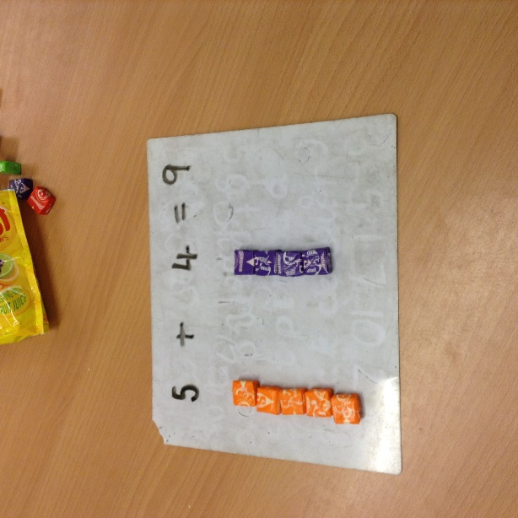
+ Addition +
Stage 2: Moves from objects to pictures.
Live well, laugh together, learn forever
7
Notes:
Show opal fruits calculation on a number track and beadstring.

Slide 8
+ Addition +
Stage 3 and 4: This moves onto using the number track and therefore is more abstract. Once confident, the children will move to an unnumbered track.
When they are ready to progress, the children will also be jumping in jumps that are bigger than one; therefore they will be partitioning the numbers.
Stage 5: This will continue and the numbers will become bigger as the children become more confident.
Live well, laugh together, learn forever
8
Notes:
There is a current statutory spelling list. These are the Key Words that the children have to learn and we have divided them up so we can teach them over the course of the year.

Slide 9
+ Addition +
Stage 6: As the numbers get larger we introduce informal written methods such as partitioning.
Whilst we are teaching this we develop the mental strategies such as compensating, adjusting, rounding and estimating to help them find easier ways to solve calculations.
Live well, laugh together, learn forever
9
Notes:
There is a current statutory spelling list. These are the Key Words that the children have to learn and we have divided them up so we can teach them over the course of the year.

Slide 10
+ Addition +
Stage 7: Expanded column method. 36 + 58 =
Live well, laugh together, learn forever
10
Notes:
There is a current statutory spelling list. These are the Key Words that the children have to learn and we have divided them up so we can teach them over the course of the year.

Slide 11
+ Addition +
Stage 8: Compact column method.
The numbers then increase in difficulty as the children become more confident with the strategy.
Live well, laugh together, learn forever
11
Notes:
There is a current statutory spelling list. These are the Key Words that the children have to learn and we have divided them up so we can teach them over the course of the year.

Slide 12
Progression in Subtraction
Live well, laugh together, learn forever
Notes:
Give parents a moment to think about the way they learn to spell and write…. Take a couple of responses? Talk about the fact that most people don’t actually remember because they were so young!

Slide 13
Stage 1: Children begin to understand subtraction as taking away. Using everyday objects they start with a group, take some away and count what is left.
Live well, laugh together, learn forever
Notes:
Give parents a moment to think about the way they learn to spell and write…. Take a couple of responses? Talk about the fact that most people don’t actually remember because they were so young!

Slide 14
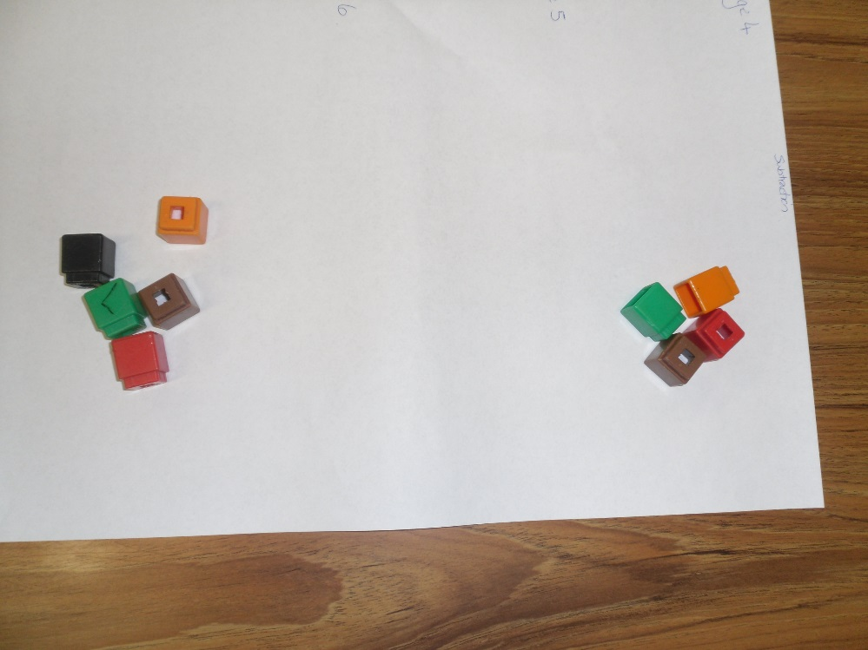
Example

Slide 15
Stage 2: Children begin to use number lines, number tracks or bead strings to solve subtraction calculations by starting on the largest number and counting backwards by the subtracted number.
Live well, laugh together, learn forever

Slide 16
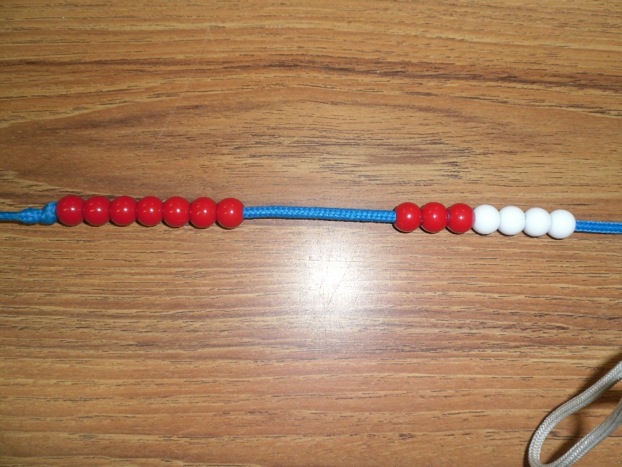
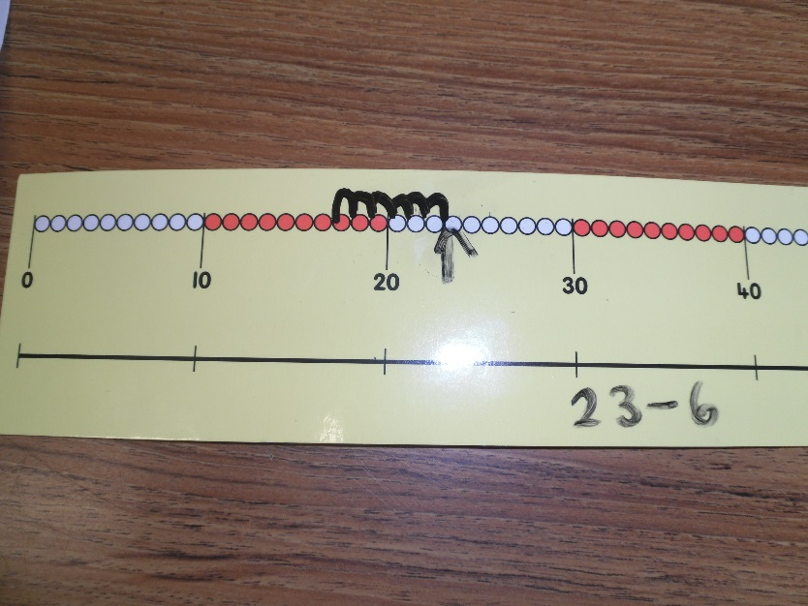
Examples

Slide 17
Stage 3: Children will begin to use empty number lines to support calculations.
First counting back in ones
Then counting back in tens and ones
Followed by subtracting the tens in one jump and the units in one jump.
Live well, laugh together, learn forever

Slide 18
Stage 4: Children are taught an alternative method for solving subtraction calculations where they need to ’find the difference’. Children count on from the smaller number to the larger number.
First using objects and counting on in ones (including money)
Then using a bead string or number line and counting in tens and ones.
Live well, laugh together, learn forever

Slide 19
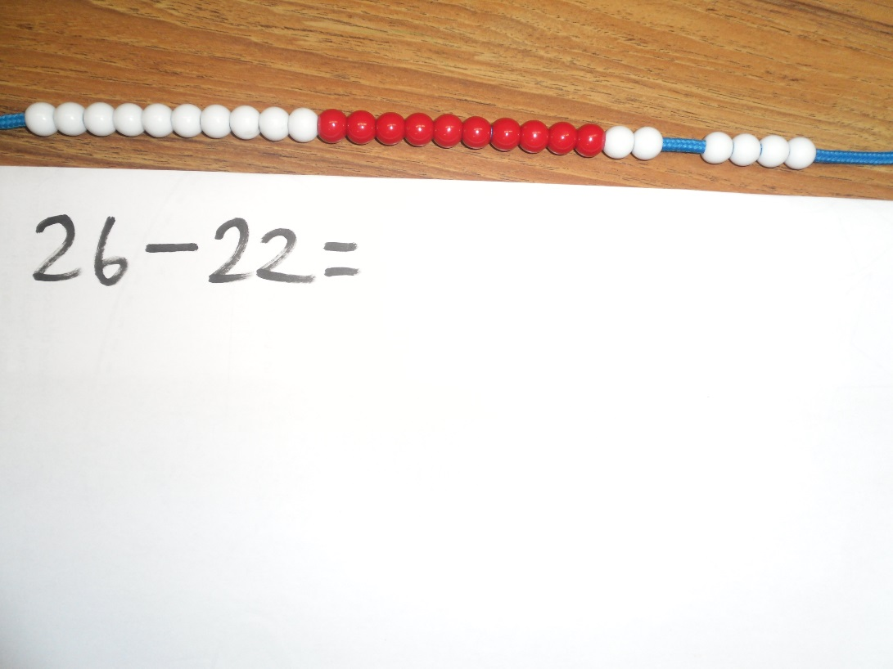
Examples

Slide 20
Stage 5: Children use the column method for subtraction involving numbers that do not require regrouping.
First using objects to represent amounts
Then arranging numbers using their place value knowledge
Next recording this representation
Followed by developing a consistent method of laying out a calculation
Live well, laugh together, learn forever

Slide 21
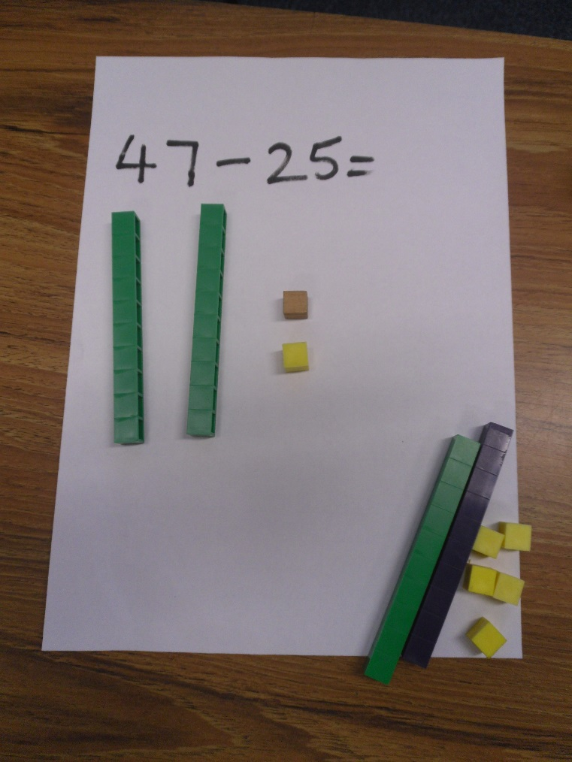
Examples

Slide 22
Stage 6: Children use the column method for subtraction involving numbers that require regrouping.
First using objects to represent the regrouping of a number
Then recording this representation
This is followed by developing a consistent method of laying out a calculation, preparing the groundwork for more formal methods of calculation.
Live well, laugh together, learn forever

Slide 23
Stage 6 continued: Children should extend the regrouping method to numbers with decimals in a range of contexts e.g. money and measurement
At this point, as with addition, place value knowledge it vital. Children need to understand that decimal points should line up under each other in column calculations, particularly when adding or subtracting mixed amounts, e.g. £3.59 + 78p. To achieve this, children need the flexibility of thinking to recognise and understand that 79p is actually a decimal of whole pounds - £ 0.79.
Live well, laugh together, learn forever

Slide 24
Stage 7: Compact column method of subtraction.
The children’s place value knowledge is at a point where they can begin to make the process more compact and therefore more efficient.
This is then used in a variety of different contexts, and by presenting the calculations in a number of different ways. For example: 1549 – 901 = or 1549 = 648 + ???
Live well, laugh together, learn forever

Slide 25
Multiplication
Before we start …
Key knowledge and skills:
Developing use of multiplication tables –
Expectations
Live well, laugh together, learn forever

Slide 26
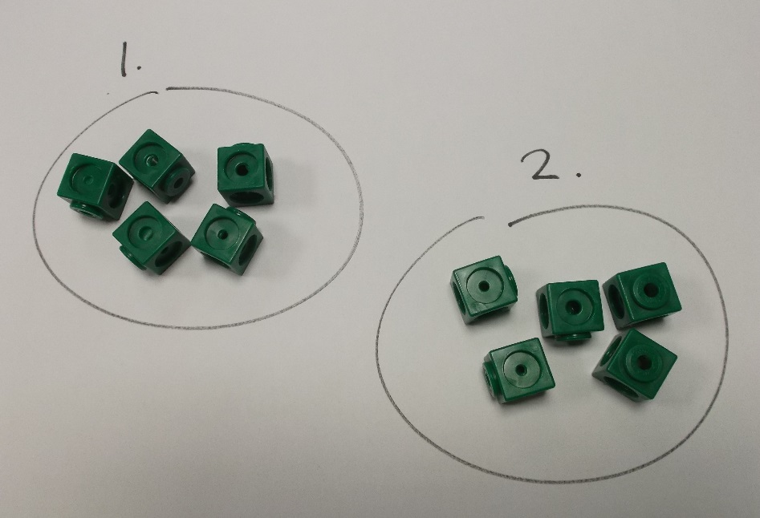
Multiplication
Stage 1
Children will use their counting skills to count objects that are in groups of two, five and ten.
If I have two groups of two objects – how many do I have in total?
Key vocabulary – altogether, groups of, lots of, how many, total
Live well, laugh together, learn forever

Slide 27
Multiplication
Stage 2
Children develop an understanding that multiplication is repeated addition – they can do this using a bead-string, numbered line, or blank number line.
Children understand – and can demonstrate – that multiplication is commutative: 5 x 3 gives the same answer as 3 x 5.
Key vocabulary – altogether, groups of, lots of, how many, times, multiply, total
Live well, laugh together, learn forever

Slide 28
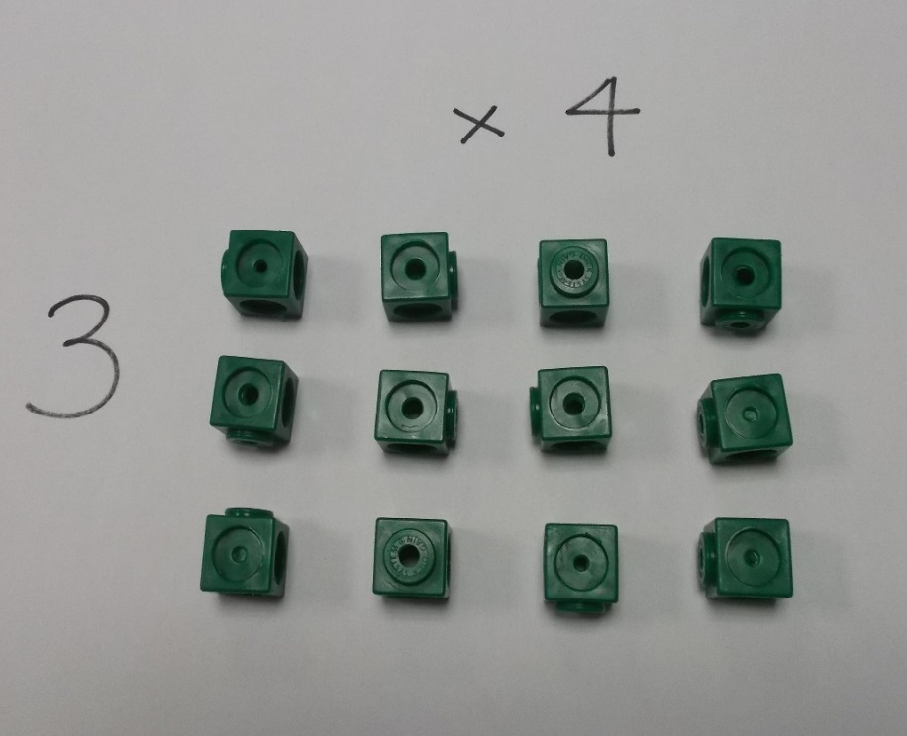
Multiplication
Stage 3
Children can show a multiplication calculation as an “array”. Repeated sets of dots, or squares shows what numbers are multiplied, while the total number of dots, or squares shows the answer of the multiplication.
Key vocabulary – altogether, groups of, lots of, how many, times, multiply, multiples, product, total
Live well, laugh together, learn forever

Slide 29
Multiplication
Stage 4
Children will continue to use arrays, and will partition numbers (where appropriate) to lead into the grid method of multiplication.
Multiplying by 10, 100 etc. using Place Value
Key vocabulary – altogether, groups of, lots of, how many, times, multiply, multiples, product, total
Live well, laugh together, learn forever

Slide 30
Multiplication
Stage 5
Children move on to the grid method as their first formal written method. 23 x 16 =
Key vocabulary – altogether, groups of, lots of, how many, times, multiply, multiples, product, total
Live well, laugh together, learn forever

Slide 31
Multiplication
Stage 6
Children use the grid method to multiply numbers that have decimals. 2.3 x 1.6 =
Key vocabulary – altogether, groups of, lots of, how many, times, multiply, multiples, product, total
Live well, laugh together, learn forever

Slide 32
Multiplication
Stage 7
Children can explore alternative methods for multiplication, including column method – extended and then compact
24 x 16 =
Key vocabulary – altogether, groups of, lots of, how many, times, multiply, multiples, product, total
Live well, laugh together, learn forever

Slide 33
Progression of Division
Live well, laugh together, learn forever
Notes:
Give parents a moment to think about the way they learn to spell and write…. Take a couple of responses? Talk about the fact that most people don’t actually remember because they were so young!

Slide 34
Stage 1: Children begin to solve division calculations by sharing in practical situations using everyday objects.
You have 10 sweets, could you share them between you and me so it is equal.
There are 12 biscuits and 4 children. How many biscuits can they each have?
There are 6 cars and three friends. Can you share them fairly?
Live well, laugh together, learn forever
Notes:
KKD

Slide 35
Stage 2: Children solve division calculations using sharing and record this using dots in circles.
12 ÷ 3 =
There are 12 strawberries to be shared between 3 children. How many do they have each?
Live well, laugh together, learn forever
Notes:
KKD
Picture of strawberries x12
Put in to 3 groups
Write number sentence
Show array

Slide 36
Stage 2: Children solve division calculations using sharing and record this using dots in circles.
12 ÷ 3 =
There are 12 strawberries to be shared between 3 children. How many do they have each?
Live well, laugh together, learn forever
Notes:
KKD
Picture of strawberries x12
Put in to 3 groups
Write number sentence
Show array

Slide 37
Stage 3: Children begin to solve division calculations by grouping everyday objects in to equal groups.
There are 16 children to be split into 4 teams. How many children will there be in each team?
Live well, laugh together, learn forever
Notes:
KKD
Pictures of children x16
Put into 4 teams
Show calculation
Show array

Slide 38
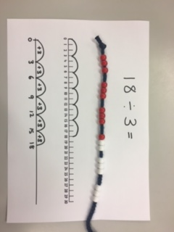
Stage 4: Children use a beadstring, numbered line or blank numberline as a representation of the grouping method for solving division calculations.
18 ÷ 3 =
Live well, laugh together, learn forever
Notes:
KKD
Model each method

Slide 39
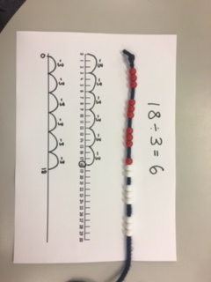
Stage 5: Children use repeated subtraction on a bead string, numbered line or blank numberline as a method for solving division calculations.
18 ÷ 3 =
Live well, laugh together, learn forever
Notes:
KKD
Model each method

Slide 40
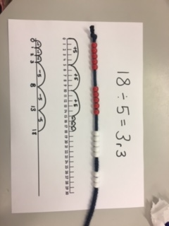
Stage 6: Children move on to solving division calculations involving remainders. Any remainders should be shown as integers, i.e. 14 remainder 2 or 14 r 2.
18 ÷ 5 =
Live well, laugh together, learn forever
Notes:
KKD

Slide 41
Stage 7: Children develop their use of repeated subtraction, using larger ’jumps’ to move along the numberline.
90 ÷ 5 =
Live well, laugh together, learn forever
Notes:
AW/KS
AW to talk through KS to model writing

Slide 42
Stage 8: Children use a vertical numberline for repeated subtraction, recording the process to link into the ‘chunking’ method. Children use this method as a basis for recording efficient jumps counting on or back
165 ÷ 5 =
Live well, laugh together, learn forever
Notes:
AW/KS
AW to talk through KS to model writing

Slide 43
Stage 9: Children use a standard written method for solving division calculation including the calculation of decimals, rather than remainders. This method is commonly know as the “bus stop” method.
165 ÷ 5 =
Live well, laugh together, learn forever
Notes:
AW/KS
AW to talk through KS to model writing

Slide 44
Stage 10: Children extend the use of “bus stop” method to include larger numbers using the process known as “long division”.
1065 ÷ 15 =
Live well, laugh together, learn forever
Notes:
AW/KS
AW to talk through KS to model writing

Slide 45
Challenge:
I have a tin of chocolates, there are _______ in it. There are ______ of you, if you take 2 each, how many will be left for the staff?!
Live well, laugh together, learn forever
Notes:
Bring in tin!

Slide 46
Fractions
Live well, laugh together, learn forever
Notes:
Give parents a moment to think about the way they learn to spell and write…. Take a couple of responses? Talk about the fact that most people don’t actually remember because they were so young!

Slide 47
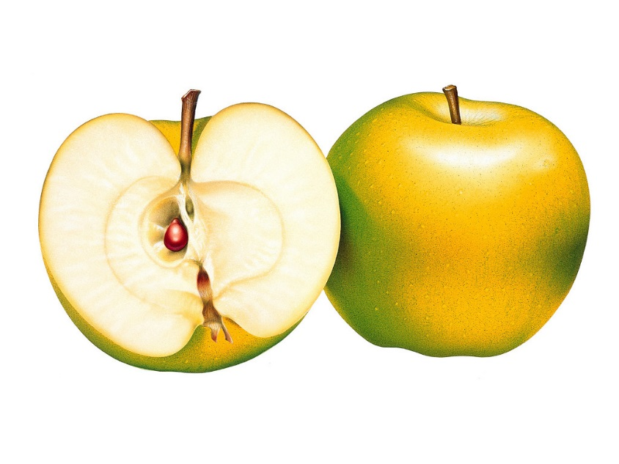
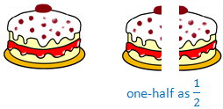
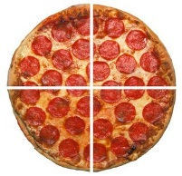
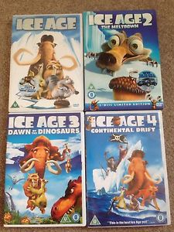
Stage 1
Live well, laugh together, learn forever
Notes:
In foundation stage & Year 1, you would encourage them to use the vocabulary, and then begin to express the idea of fraction in relation to physical options. You might get a cake in school and begin to cut, or have physical objects for them to sort. Language – sharing, giving, dividing between
½, ¼, 2/4, 3/4

Slide 48
Stage 2
Gradual introduction of more fractions and when numerator is greater than 1.
Counting in fractions.
Live well, laugh together, learn forever
Notes:
Exploring fractions when the numerator is greater than one. Counting in fractions using a number stick as a base (counting in halves originally) – children would have used this previously but again it is about showing their flexibility in counting. Again concreting their thoughts / fractions with images, objects to bridge the gap between stages.

Slide 49
Stage 3
Identify, name and write unit fractions up to 1/12.
Compare and order fractions with same denominators.
Children will add/subtract with same denominator and within one whole.
Equivalence to one.
Live well, laugh together, learn forever
Notes:
Emphasise the use of writing fractions as they’re entering into KS2 and more comparison – more done visually to begin with. Fraction and image next to each other, and children can physically see the difference.

Slide 50
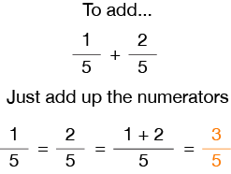
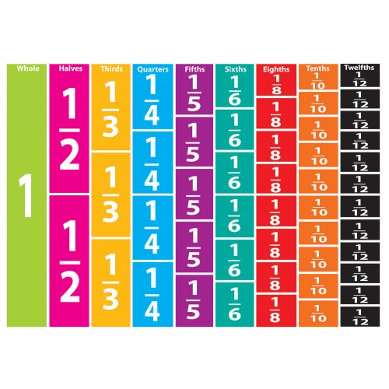
Live well, laugh together, learn forever
Notes:
Emphasise the use of writing fractions as they’re entering into KS2 and more comparison – more done visually to begin with. Fraction and image next to each other, and children can physically see the difference.

Slide 51
Stage 4
Equivalent fractions with a denominator not greater than 12
Reduce fractions to their simplest form ( 8 / 24)
Add / subtract two fractions with common denominator within one whole (1/4 + 5/8 = )
Live well, laugh together, learn forever
Notes:
Model reducing fractions on the board – explore how they would half the fractions to begin with but as they get more confident they’ll be able to see what numbers go into the fractions at the first time of asking rather than going through the halving stages.
Model the idea of adding fractions with common denominator – explore how you’d do it on the board.

Slide 52
Stage 5
Compare and order fractions with different denominators. (3/8, 1/4, 7/8, 1/2)
Mixed number / improper fractions.
Add /subtract fractions with going above 1 as a question. (2/5 + 4/5 = 6/5 or 1 1/5).
Multiply proper fractions and mixed numbers by whole numbers. (2/5 x 5 = & 1 3/4 x 6= )
Live well, laugh together, learn forever
Notes:
Model how you would go about comparing the fractions on the board and explain that the children realise that they can’t compare the fractions with different denominators so have to find a common denominator.

Slide 53
Stage 6
Add/subtract mixed numbers with different denominator. (4/6 + 2/9 = )
Multiply proper fractions writing answers in simplest form. (3/4 x 6/8 = )
Divide proper fractions by whole numbers.
(3/8 ÷ 3 & 4/7 ÷ 5)
Decimal / percentage association with fractions.
Live well, laugh together, learn forever
Notes:
Discuss the idea of finding a common denominator when adding/subtracting, and discuss/ model the techniques when multiplying & dividing fractions. Show video shown in class to explain dividing fractions.

